Slide 1

William Stallings Computer Organization and Architecture 8th Edition
Chapter 18
Multicore Computers

Slide 2
Hardware Performance Issues
Microprocessors have seen an exponential increase in performance
Improved organization
Increased clock frequency
Increase in Parallelism
Pipelining
Superscalar
Simultaneous multithreading (SMT)
Diminishing returns
More complexity requires more logic
Increasing chip area for coordinating and signal transfer logic
Harder to design, make and debug

Slide 3
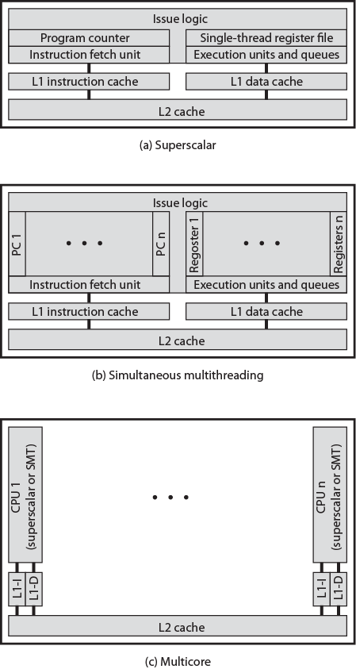
Alternative Chip Organizations

Slide 4
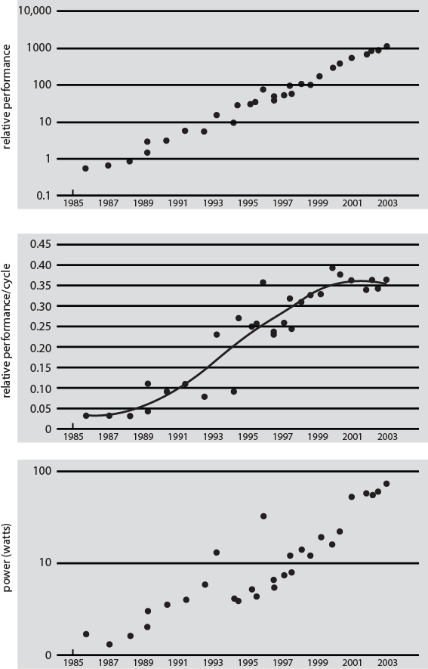
Intel Hardware Trends

Slide 5
Increased Complexity
Power requirements grow exponentially with chip density and clock frequency
Can use more chip area for cache
Smaller
Order of magnitude lower power requirements
By 2015
100 billion transistors on 300mm² die
Cache of 100MB
1 billion transistors for logic
Pollack’s rule:
Performance is roughly proportional to square root of increase in complexity
Double complexity gives 40% more performance
Multicore has potential for near-linear improvement
Unlikely that one core can use all cache effectively

Slide 6
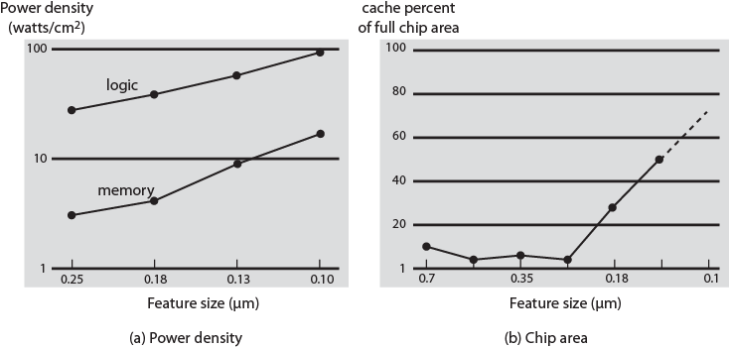
Power and Memory Considerations

Slide 7
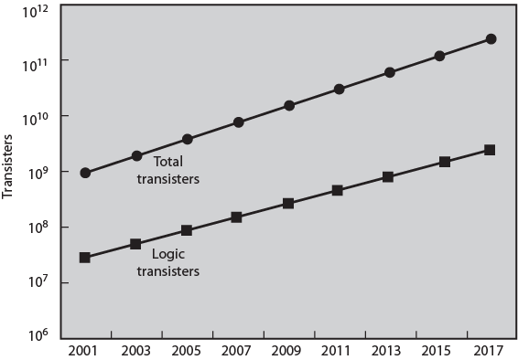
Chip Utilization of Transistors

Slide 8
Software Performance Issues
Performance benefits dependent on effective exploitation of parallel resources
Even small amounts of serial code impact performance
10% inherently serial on 8 processor system gives only 4.7 times performance
Communication, distribution of work and cache coherence overheads
Some applications effectively exploit multicore processors

Slide 9
Effective Applications for Multicore Processors
Database
Servers handling independent transactions
Multi-threaded native applications
Lotus Domino, Siebel CRM
Multi-process applications
Oracle, SAP, PeopleSoft
Java applications
Java VM is multi-thread with scheduling and memory management
Sun’s Java Application Server, BEA’s Weblogic, IBM Websphere, Tomcat
Multi-instance applications
One application running multiple times
E.g. Value Game Software

Slide 10
Multicore Organization
Number of core processors on chip
Number of levels of cache on chip
Amount of shared cache
Next slide examples of each organization:
(a) ARM11 MPCore
(b) AMD Opteron
(c) Intel Core Duo
(d) Intel Core i7

Slide 11
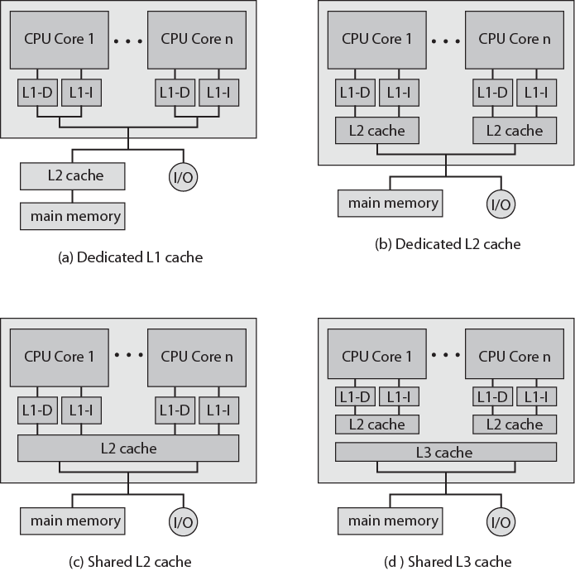
Multicore Organization Alternatives

Slide 12
Advantages of shared L2 Cache
Constructive interference reduces overall miss rate
Data shared by multiple cores not replicated at cache level
With proper frame replacement algorithms mean amount of shared cache dedicated to each core is dynamic
Threads with less locality can have more cache
Easy inter-process communication through shared memory
Cache coherency confined to L1
Dedicated L2 cache gives each core more rapid access
Good for threads with strong locality
Shared L3 cache may also improve performance

Slide 13
Individual Core Architecture
Intel Core Duo uses superscalar cores
Intel Core i7 uses simultaneous multi-threading (SMT)
Scales up number of threads supported
4 SMT cores, each supporting 4 threads appears as 16 core

Slide 14
Intel x86 Multicore Organization - Core Duo (1)
2006
Two x86 superscalar, shared L2 cache
Dedicated L1 cache per core
32KB instruction and 32KB data
Thermal control unit per core
Manages chip heat dissipation
Maximize performance within constraints
Improved ergonomics
Advanced Programmable Interrupt Controlled (APIC)
Inter-process interrupts between cores
Routes interrupts to appropriate core
Includes timer so OS can interrupt core

Slide 15
Intel x86 Multicore Organization - Core Duo (2)
Power Management Logic
Monitors thermal conditions and CPU activity
Adjusts voltage and power consumption
Can switch individual logic subsystems
2MB shared L2 cache
Dynamic allocation
MESI support for L1 caches
Extended to support multiple Core Duo in SMP
L2 data shared between local cores or external
Bus interface

Slide 16
Intel x86 Multicore Organization - Core i7
November 2008
Four x86 SMT processors
Dedicated L2, shared L3 cache
Speculative pre-fetch for caches
On chip DDR3 memory controller
Three 8 byte channels (192 bits) giving 32GB/s
No front side bus
QuickPath Interconnection
Cache coherent point-to-point link
High speed communications between processor chips
6.4G transfers per second, 16 bits per transfer
Dedicated bi-directional pairs
Total bandwidth 25.6GB/s

Slide 17
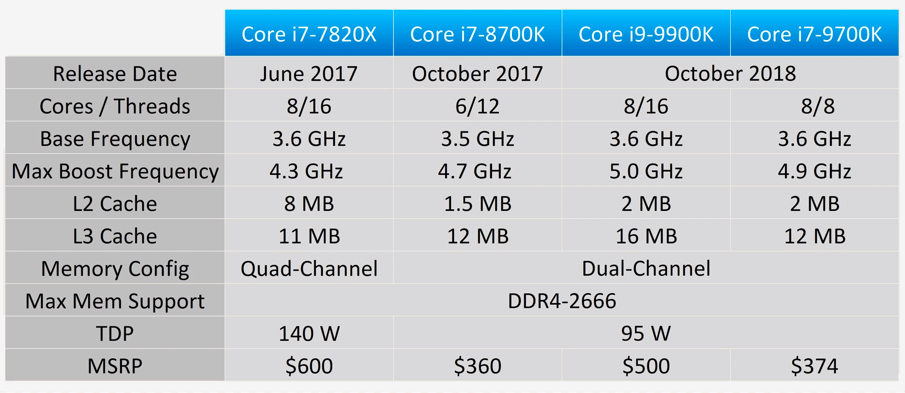
Comparation i7

Slide 18
ARM11 MPCore
Up to 4 processors each with own L1 instruction and data cache
Distributed interrupt controller
Timer per CPU
Watchdog
Warning alerts for software failures
Counts down from predetermined values
Issues warning at zero
CPU interface
Interrupt acknowledgement, masking and completion acknowledgement
CPU
Single ARM11 called MP11
Vector floating-point unit
FP co-processor
L1 cache
Snoop control unit
L1 cache coherency

Slide 19
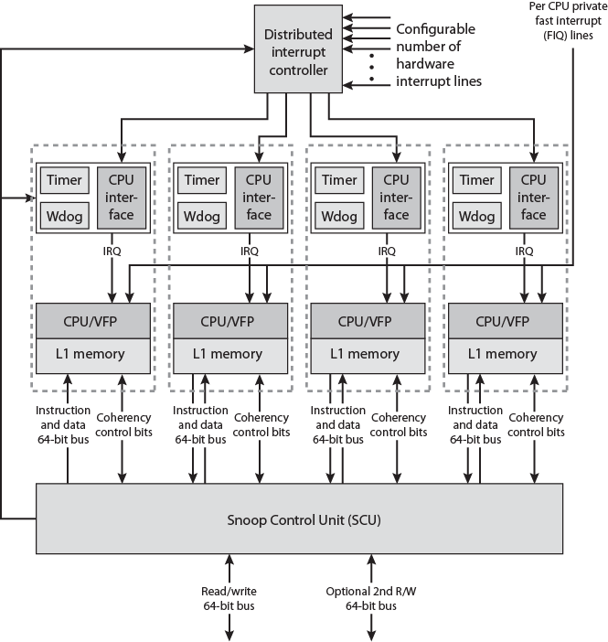
ARM11 MPCore Block Diagram

Slide 20
ARM11 MPCore Interrupt Handling
Distributed Interrupt Controller (DIC) collates from many sources
Masking
Prioritization
Distribution to target MP11 CPUs
Status tracking
Software interrupt generation
Number of interrupts independent of MP11 CPU design
Memory mapped
Accessed by CPUs via private interface through SCU
Can route interrupts to single or multiple CPUs
Provides inter-process communication
Thread on one CPU can cause activity by thread on another CPU

Slide 21
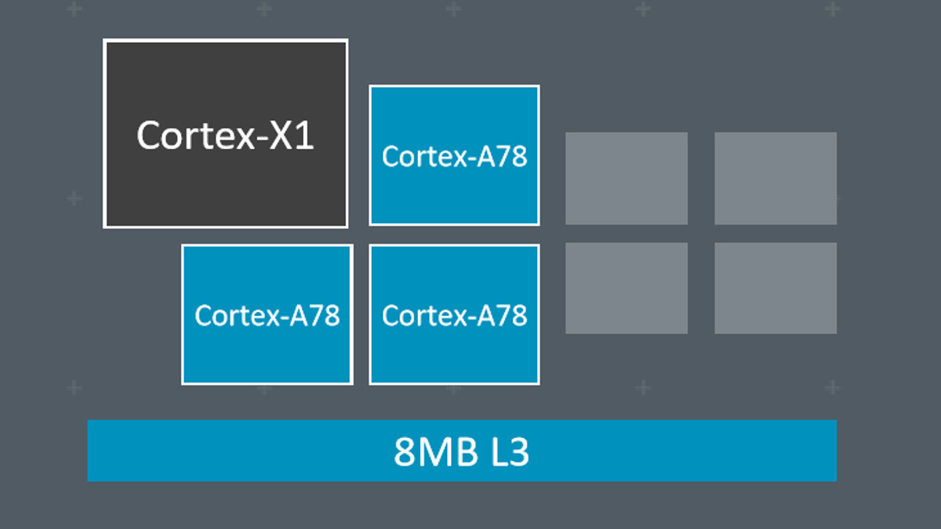
New ARM Cortex

Slide 22
DIC Routing
Direct to specific CPU
To defined group of CPUs
To all CPUs
OS can generate interrupt to:
All but self
Self
Other specific CPU
Typically combined with shared memory for inter-process communication
16 interrupt ids available for inter-process communication

Slide 23
Interrupt States
Inactive
Non-asserted
Completed by that CPU but pending or active in others
Pending
Asserted
Processing not started on that CPU
Active
Started on that CPU but not complete
Can be pre-empted by higher priority interrupt

Slide 24
Interrupt Sources
Inter-process Interrupts (IPI)
Private to CPU
ID0-ID15
Software triggered
Priority depends on target CPU not source
Private timer and/or watchdog interrupt
ID29 and ID30
Legacy FIQ line
Legacy FIQ pin, per CPU, bypasses interrupt distributor
Directly drives interrupts to CPU
Hardware
Triggered by programmable events on associated interrupt lines
Up to 224 lines
Start at ID32

Slide 25
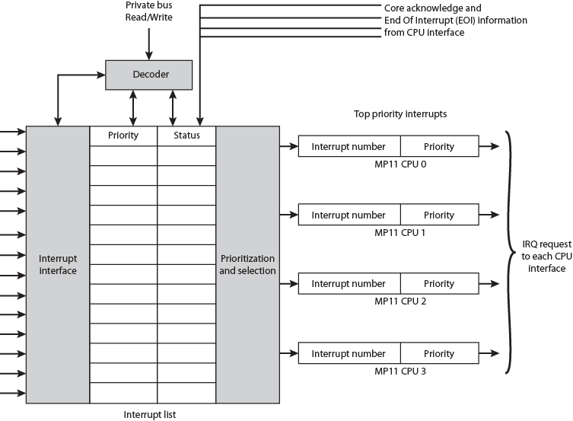
ARM11 MPCore Interrupt Distributor

Slide 26
Cache Coherency
Snoop Control Unit (SCU) resolves most shared data bottleneck issues
L1 cache coherency based on MESI
Direct data Intervention
Copying clean entries between L1 caches without accessing external memory
Reduces read after write from L1 to L2
Can resolve local L1 miss from rmote L1 rather than L2
Duplicated tag RAMs
Cache tags implemented as separate block of RAM
Same length as number of lines in cache
Duplicates used by SCU to check data availability before sending coherency commands
Only send to CPUs that must update coherent data cache
Migratory lines
Allows moving dirty data between CPUs without writing to L2 and reading back from external memory

Slide 27
Recommended Reading
Stallings chapter 18
ARM web site

Slide 28
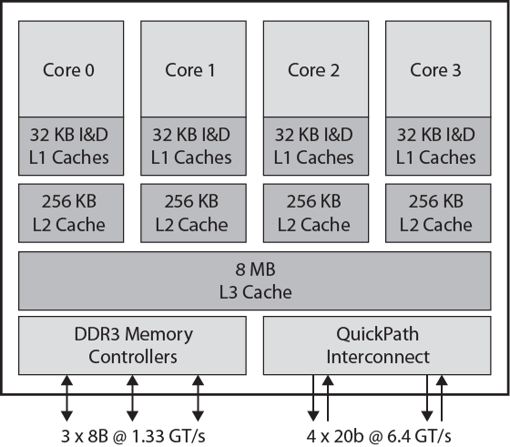
Intel Core i& Block Diagram

Slide 29
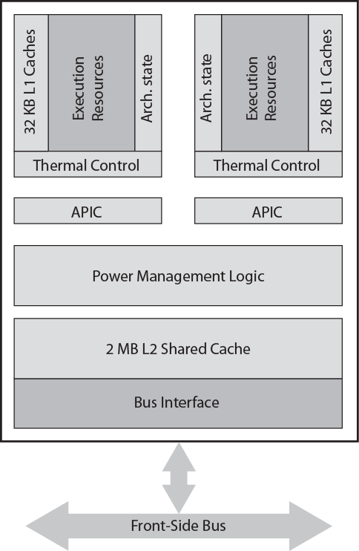
Intel Core Duo Block Diagram

Slide 30
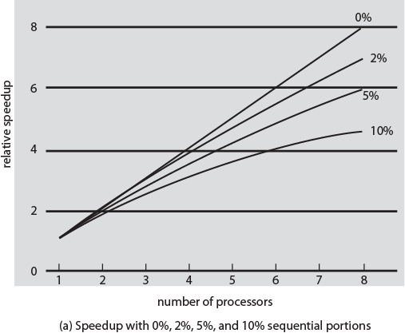
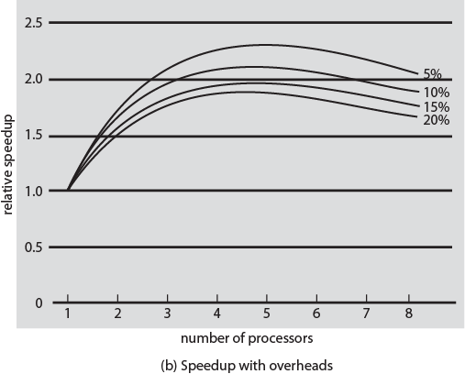
Performance Effect of Multiple Cores

Slide 31
Recommended Reading
Multicore Association web site
ARM web site

